Slide 1
Drawing and Coordinate Systems

Slide 2
Coordinate System "Handedness
In a 2-D coordinate system the X axis generally points from left to right, and the Y axis generally points from bottom to top.
( Although some windowing systems will have their Y coordinates going from top to bottom. )
When we add the third coordinate, Z, we have a choice as to whether the Z-axis points into the screen or out of the screen:

Slide 3
Z is coming out of the page +Counterclockwise rotations are positive if we rotate about the X axis : the rotation Y->Z is positive if we rotate about the Y axis : the rotation Z->X is positive if we rotate about the Z axis : the rotation X->Y is positive Left Hand Coordinate System (LHS)
Z is going into the page Clockwise rotations are positive if we rotate about the X axis : the rotation Y->Z is positive if we rotate about the Y axis : the rotation Z->X is positive if we rotate about the Z axis : the rotation X->Y is positive

Slide 4
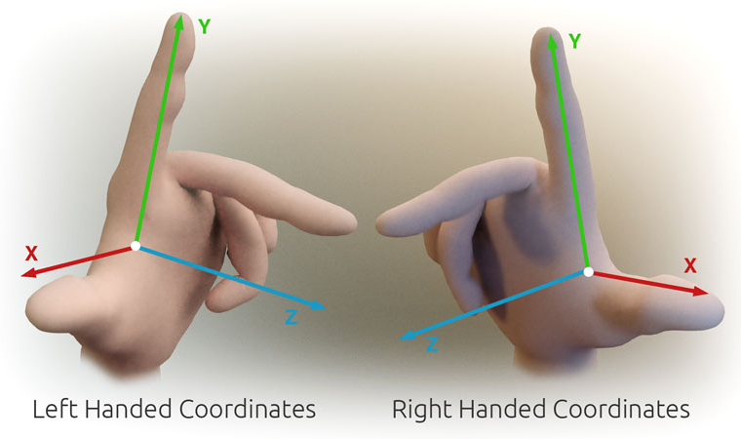

Slide 5
The viewport refers to the region of the screen where the rendered graphics are displayed. It's essentially the area of the window or screen where the graphics are visible to the user. Viewport settings can include parameters like position, size, and aspect ratio, determining how the rendered scene is displayed on the screen.

Slide 6
Orthographic 2D projection is a way of showing 2D graphics on a screen without making faraway objects look smaller or closer ones larger. It keeps everything the same size no matter how far away it is. It's like looking at a flat picture where everything stays the same size, regardless of how far away it is in the scene.

Slide 7
Coordinate Systems
World Coordinate system
World window
Screen Coordinate system
Viewport
Window to viewport mapping
Notes:
MODEL/WORLD WINDOW-TO-VIEWPORT COORDINATE TRANSFORMATION
A world-coordinate area selected for display is called a window.
An area on a display device to which a window is mapped is called a viewport.
The window defines what is to be viewed; the viewport defines where it is to be displayed.

Slide 8
MODEL/WORLD WINDOW-TO-VIEWPORT COORDINATE TRANSFORMATION
A world-coordinate area selected for display is called a window.
An area on a display device to which a window is mapped is called a viewport.
The window defines what is to be viewed; the viewport defines where it is to be displayed.

Slide 9
Screen Coordinate System
2D Regular Cartesian Grid
Origin (0,0) at lower left
corner (OpenGL convention)
Horizontal axis – x
Vertical axis – y
Pixels are defined at the grid intersections
This coordinate system is defined relative to the display window origin
(OpenGL: the lower left corner of the window)
(0,0)
y
x
(2,2)

Slide 10
World Coordinate System
10 feet
20 feet

Slide 11
Define a world window

Slide 12
World Window
World window – a rectangular region in the world that is to be displayed
W_T
Define by
W_L, W_R, W_B, W_T
W_B
Use OpenGL command:
gluOrtho2D(left, right, bottom,
top)
W_L
W_R

Slide 13
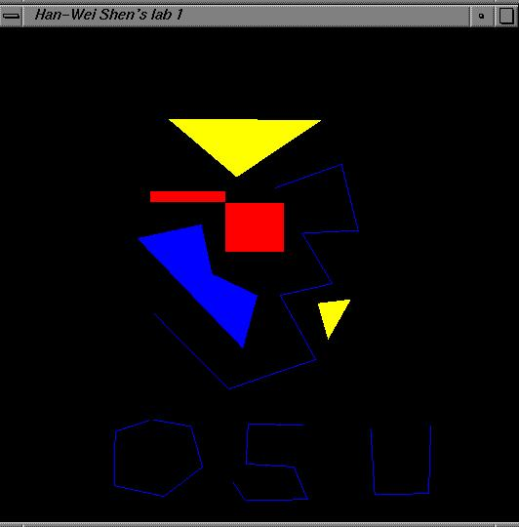
Viewport
The rectangular region in the screen for displaying the graphical objects defined in the world window
Defined in the screen coordinate system
glViewport(int left, int bottom, int (right-left), int (top-bottom));
call this function before drawing (calling glBegin() and glEnd() )
V_T
V_B
V_L
V_R

Slide 15
To draw in world coordinate system
Three tasks need to be done
Define a rectangular world window
(call an OpenGL function)
Define a viewport (call an OpenGL function)
Perform window to viewport mapping

Slide 16
Window to viewport mapping
The objects in the world window will then be drawn onto the viewport
(x,y)
viewport
World window
(Sx, Sy)
Notes:
Panning
Moving the window around the world
Zooming
Reducing/increasing the window size
Tiling
W-to-V in loop, adjacent viewports
Flipping drawings

Slide 17
Window to viewport mapping
How to calculate (sx, sy) from (x,y)?
(x,y)
(Sx, Sy)

Slide 18
Window to viewport mapping
Before calling gluOrtho2D(), you need to have the following two lines of code –
glMatrixMode(GL_PROJECTION);
glLoadIdentity();
Things that are given:
The world window (W_L, W_R, W_B, W_T) (l,r,b,t)
The viewport (V_L, V_R, V_B, V_T) (l,r,b,t)
A point (x,y) in the world coordinate system
Calculate the corresponding point (sx, sy) in the screen coordinate system

Slide 19
Window to viewport mapping
Basic principle: the mapping should be proportional
(x,y)
(sx,sy)
(x – W_L) / (W_R – W_L) = (sx – V_L) / (V_R – V_L)
(y - W_B) / (W_T – W_B) = (sy – V_B) / (V_T – V_B)

Slide 20
Window to viewport mapping
(x,y)
(sx,sy)
(x – W_L) / (W_R – W_L) = (sx – V_L) / (V_R – V_L)
(y - W_B) / (W_T – W_B) = (sy – V_B) / (V_T – V_B)
sx = x * (V_R-V_L)/(W_R-W_L) - W_L * (V_R – V_L)/(W_R-W_L) + V_L
sy = y * (V_T-V_B)/(W_T-W_B) – W_B * (V_T-V_B)/(W_T-W_B) + V_B

Slide 21
Example
What is (Sx,Sy) for point (3.4,1.2) in world coordinates if:
Hence, point (3.4,1.2) in world = point (332,176) on screen

Slide 22
Example
What is (Sx,Sy) for point (2,3) in world coordinates if:
Hence, point (2,3) in world = point (?,?) on screen
sx = x * (V_R-V_L)/(W_R-W_L) - W_L * (V_R – V_L)/(W_R-W_L) + V_L
sy = y * (V_T-V_B)/(W_T-W_B) – W_B * (V_T-V_B)/(W_T-W_B) + V_B

Slide 23
Example
What is (Sx,Sy) for point (4,5) in world coordinates if:
Hence, point (4,5) in world = point (?,?) on screen
sx = x * (V_R-V_L)/(W_R-W_L) - W_L * (V_R – V_L)/(W_R-W_L) + V_L
sy = y * (V_T-V_B)/(W_T-W_B) – W_B * (V_T-V_B)/(W_T-W_B) + V_B

Slide 24
World window set up
Find the world coordinates extent that will cover the entire scene
max Y
min Y
min X
max X

Slide 25
Zoom into the picture
Shrink your world window – call gluOrtho2D() with a new range
Viewport

Slide 26
Non-distorted viewport setup
Distortion happens when …
World window and display window have different aspect ratios
Aspect ratio is R = W / H
CASE 1: R > W / H
CASE 2: R < W / H

Slide 27
Compare aspect ratios
H
W
World window
Aspect Ratio = R
Display window
Aspect Ratio = W / H
R > W / H

Slide 28
CASE 1: R > W / H
glViewport(0, 0, W, W/R)
H
R
W/R
World window
Aspect Ratio = R
W
Display window
Aspect Ratio = W / H
R > W / H

Slide 29
Case 2: R < W / H
H
W
World window
Aspect Ratio = R
Display window
Aspect Ratio = W / H
R < W / H

Slide 30
Match Aspect Ratios
?
H
W
World window
Aspect Ratio = R
Display window
Aspect Ratio = W / H
R < W / H

Slide 31
Match aspect ratios
glViewport(0, 0, H*R, H)
H * R
H
W
World window
Aspect Ratio = R
Display window
Aspect Ratio = W / H
R < W / H

Slide 32
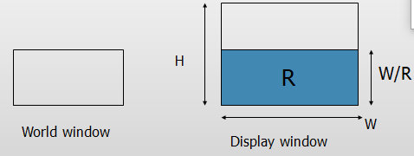
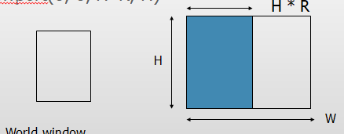
CASE 1: R > W / H glViewport(0, 0, W, W/R) CASE 2: R < W / H glViewport(0, 0, H*R, H)

Slide 33
When to call glViewport() ?
Two places:
Initialization
Default: same as the window size
When the user resizes the display window

Slide 34
Resize (Reshape) window
Void main(int argc, char** argv)
{
…
glutDisplayFunc(display);
glutReshapeFunc(resize);
glutKeyboardFunc(key);
…
}
void resize () – a function
provided by you. It will be
called when the window
changes size.

Slide 35
Resize (reshape) window
Void resize(int W, int H)
{
glViewport(0,0,W, H);
}
This is done by default in GLUT
You can use the call to make
sure the aspect ratio is
fixed that we just discussed.

Slide 36
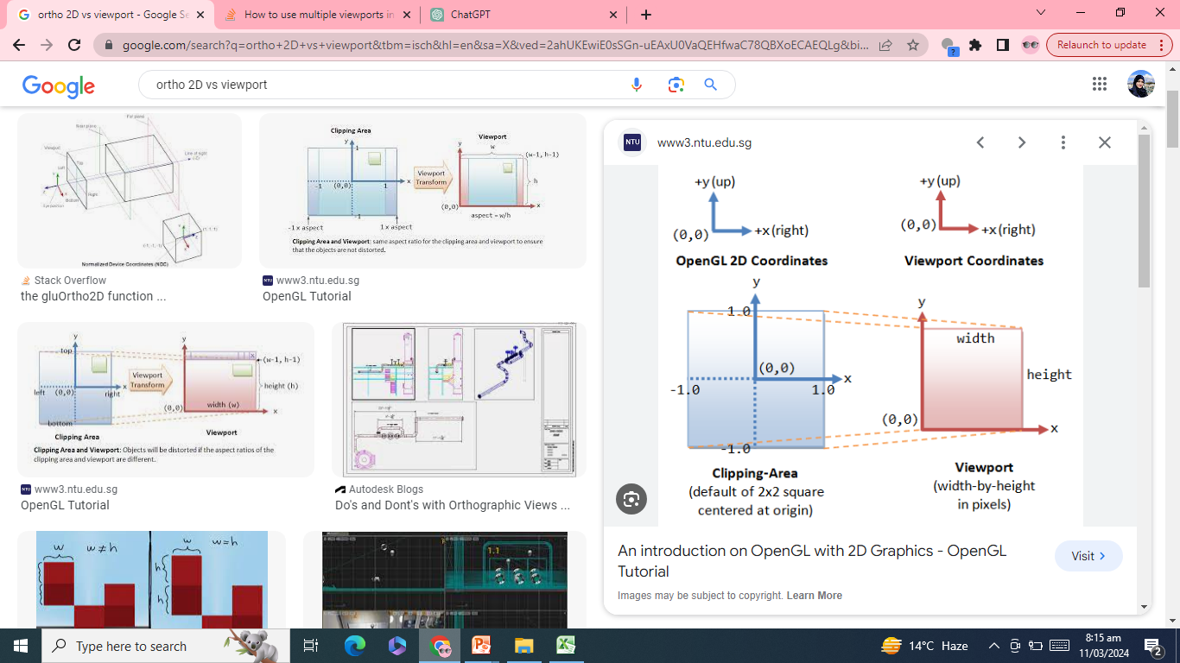

Slide 37
Put it all together
DrawQuad()
{
glViewport(0,0,300,200);
glMatrixMode(GL_PROJECTION);
glLoadIdentity();
gluOrtho2D(-1,1,-1,1);
glBegin(GL_QUADS);
glColor3f(1,1,0);
glVertex2f(-0.5,-0.5);
glVertex2f(+0.5,-0.5);
glVertex2f(+0.5,+0.5);
glVertex2f(-0.5,+0.5);
glEnd();
}
(300,200)
(0,0)
viewport
How big is the quad?

Slide 38
Well, this works too …
main()
{
…
glBegin(GL_QUADS);
glColor3f(1,1,0);
glVertex2f(-0.5,-0.5);
glVertex2f(+0.5,0);
glVertex2f(+0.5,+0.5);
glVertex2f(-0.5,+0.5);
glEnd();
}
OpenGL Default:
glViewport: as large as
you display window
gluOrtho2D:
gluOrtho2D(-1,1,-1,1);
OpenGL Default:
glViewport: as large as
you display window
gluOrtho2D:
gluOrtho2D(-1,1,-1,1);

Slide 39
Two viewports
void draw(){
// Make background color yellow
glClearColor( 100, 100, 0, 0 );
glClear ( GL_COLOR_BUFFER_BIT );
// Sets up FIRST viewport spanning the left-bottom quarter of the interface window
glViewport(0,0,250,250);
// Sets up the PROJECTION matrix
glMatrixMode(GL_PROJECTION);
glLoadIdentity();
gluOrtho2D(0.0,50.0,-10.0,40.0); // also sets up world window
// Draw BLUE rectangle
glColor3f( 0, 0, 1 );
glRectf(0.0,0.0,10.0,30.0);
// continues

Slide 40
glViewport(250,250,250,250);
// Sets up the PROJECTION matrix
glMatrixMode(GL_PROJECTION);
glLoadIdentity();
gluOrtho2D(0.0,50.0,-10.0,40.0);
// also sets up world window
// Draw RED rectangle
glColor3f( 1, 0, 0 );
glRectf(0.0,0.0,10.0,30.0);
// display rectangles
glutSwapBuffers();
} // end of draw

Slide 41
Compare aspect ratios
H
World window
W
Display window
R > W / H

Slide 42
Task3:
What is (Sx,Sy) for point (3.4,1.2) in world coordinates if:
W=(0,4,0,2)
V=(60,380,80,240)

Slide 43
TASK : Implement the function that performs the Window to Viewport Mapping.

Slide 44
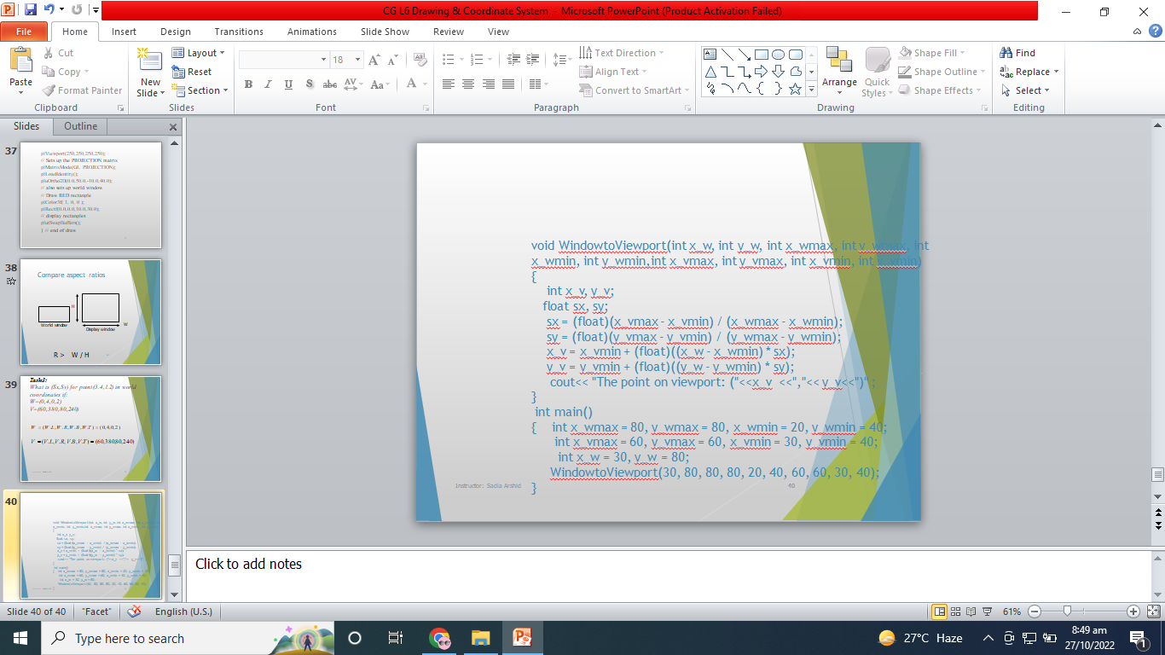
void WindowtoViewport(int x_w, int y_w, int x_wmax, int y_wmax, int x_wmin, int y_wmin,int x_vmax, int y_vmax, int x_vmin, int y_vmin) { int x_v, y_v; float sx, sy; sx = (float)(x_vmax - x_vmin) / (x_wmax - x_wmin); sy = (float)(y_vmax - y_vmin) / (y_wmax - y_wmin); x_v = x_vmin + (float)((x_w - x_wmin) * sx); y_v = y_vmin + (float)((y_w - y_wmin) * sy); cout<< "The point on viewport: ("<<x_v <<","<< y_v<<")" ; } int main() { int x_wmax = 80, y_wmax = 80, x_wmin = 20, y_wmin = 40; int x_vmax = 60, y_vmax = 60, x_vmin = 30, y_vmin = 40; int x_w = 30, y_w = 80; WindowtoViewport(30, 80, 80, 80, 20, 40, 60, 60, 30, 40); }

Slide 45
"The viewport is an area expressed in rendering device specific coordinates, e.g. pixels for screen coordinates, in which the objects of interest are going to be rendered." Based upon the above statement, determine whether it is true or false.

Slide 46
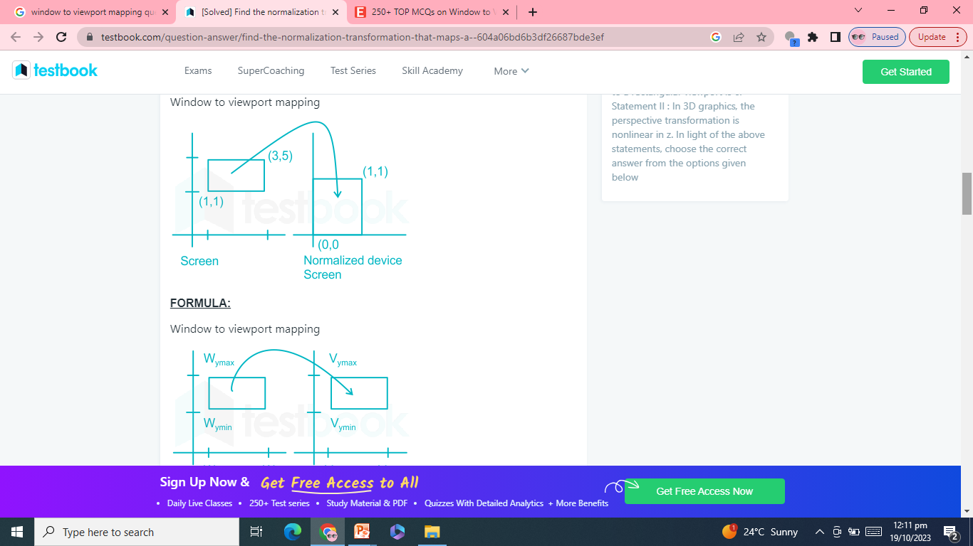

Slide 47
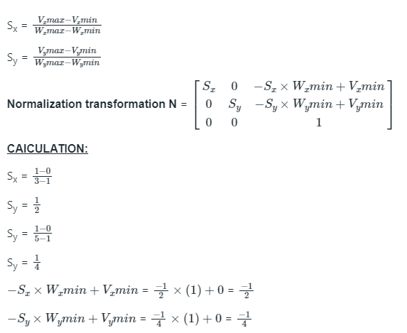


Slide 48
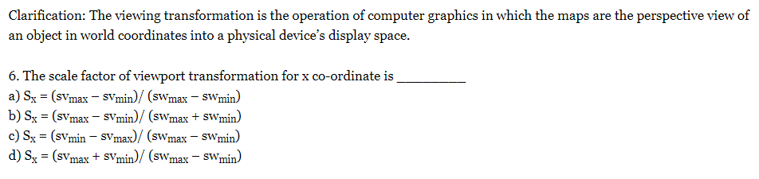
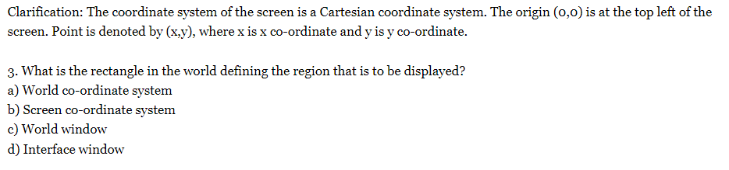

Slide 49
